Slide 1

Biodiversity patterns and how they emerge
Petr Keil

Slide 2
Latitudinal gradients of biodiversity
From the tropics towards the poles

Slide 3
Latitudinal gradient
Birds across the New World (grid cells of ~ 611,000 km²)
Storch & Gaston (2004) Basic and Applied Ecology

Slide 4
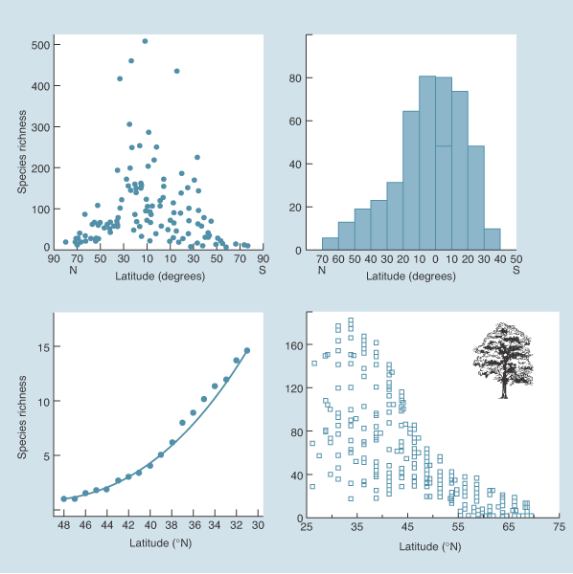
Latitudinal gradient
marine bivalves
butterflies
US lizards
trees
Begon et al. (2004) Ecology (the textbook)

Slide 5
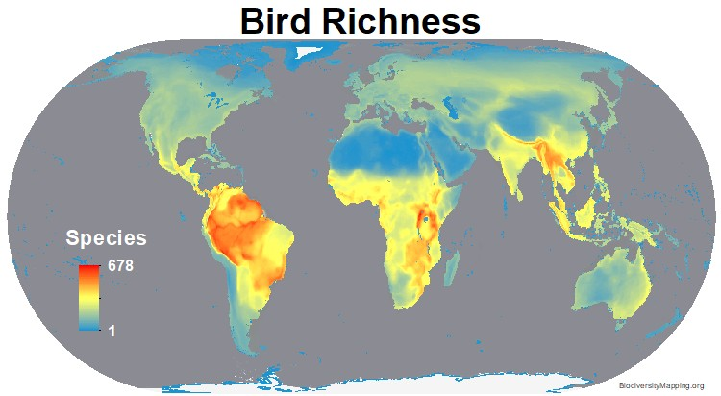
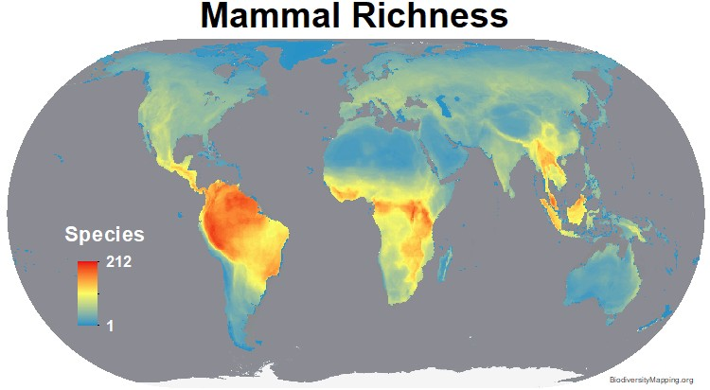
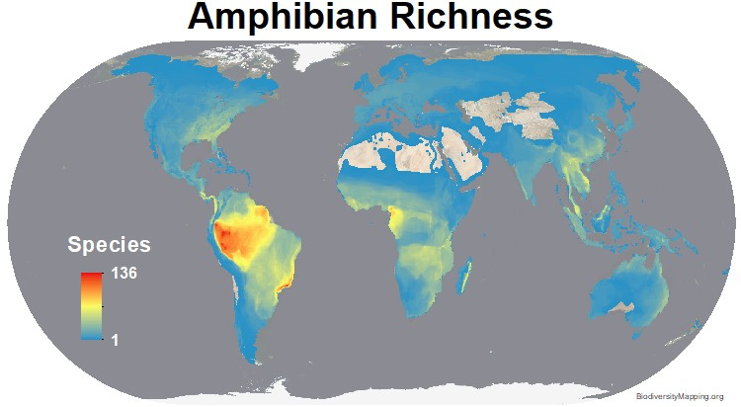
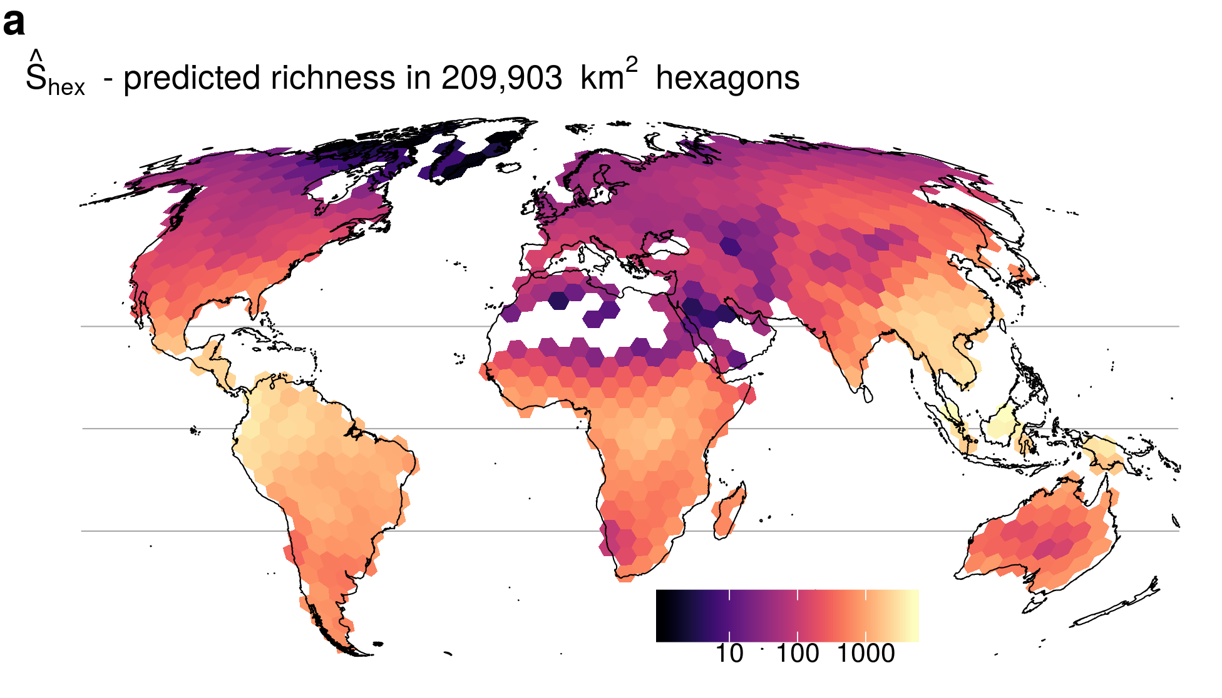
Latitudinal gradient
Tree Richness
BiodiversityMapping.org; Keil & Chase (2019) Nature Communications

Slide 6
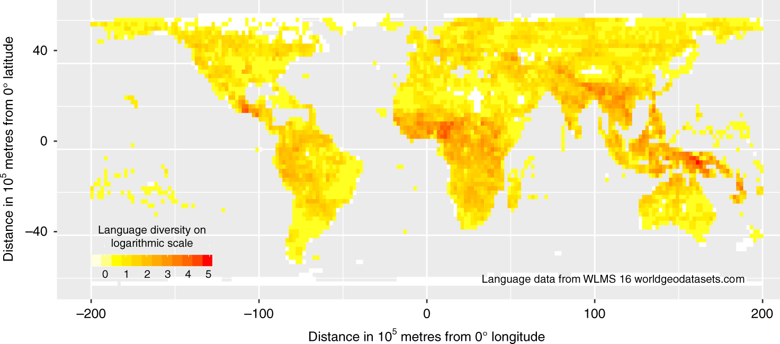
Also holds for languages
Mace & Pagel (1995) Proc R Soc B
Hua et al. (2019) Nature Communications
Notes:
In this panel we can probably all agree that biodiversity is one of the most valuable natural resources.
But things like climate change or habitat loss are a threat to biodiversity, to the extent that we hear about biodiversity crisis, or sixth mass extinction
For example, about 1% of vertebrate species have gone extinct because of humans

Slide 7
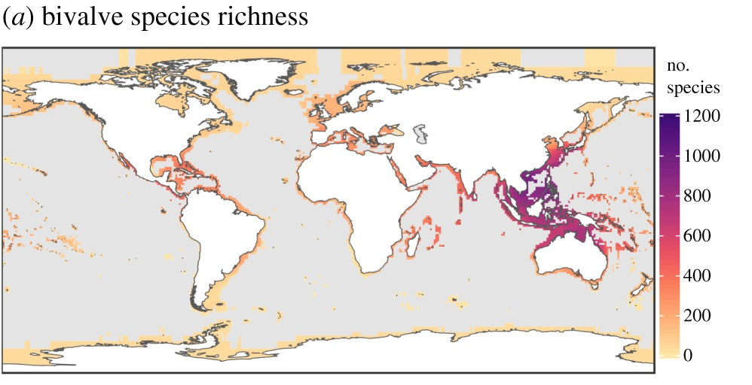
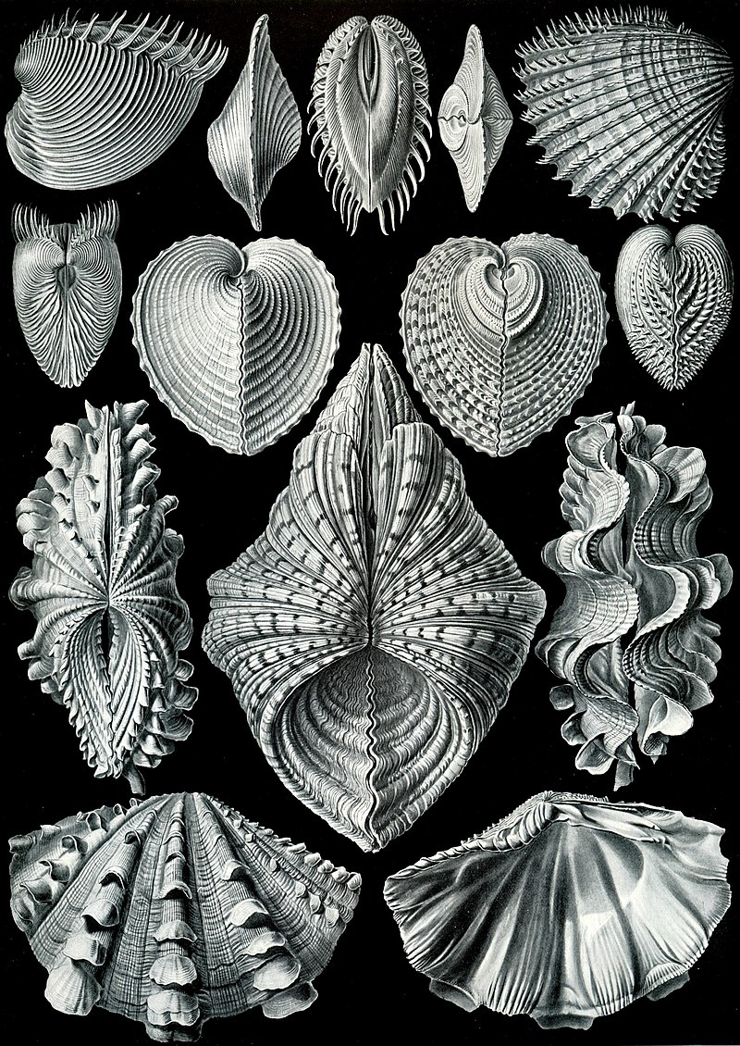
Latitudinal gradient in the sea
Schumm et al. (2019) Proc R Soc B

Slide 8
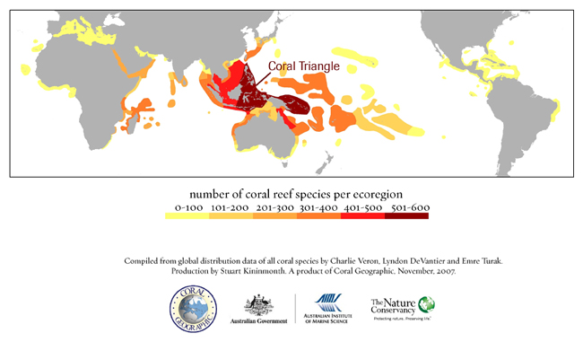
Exceptions and irregularities …

Slide 9
Exceptions and irregularities …
Keil & Chase (2019) Nature Ecology & Evolution

Slide 10
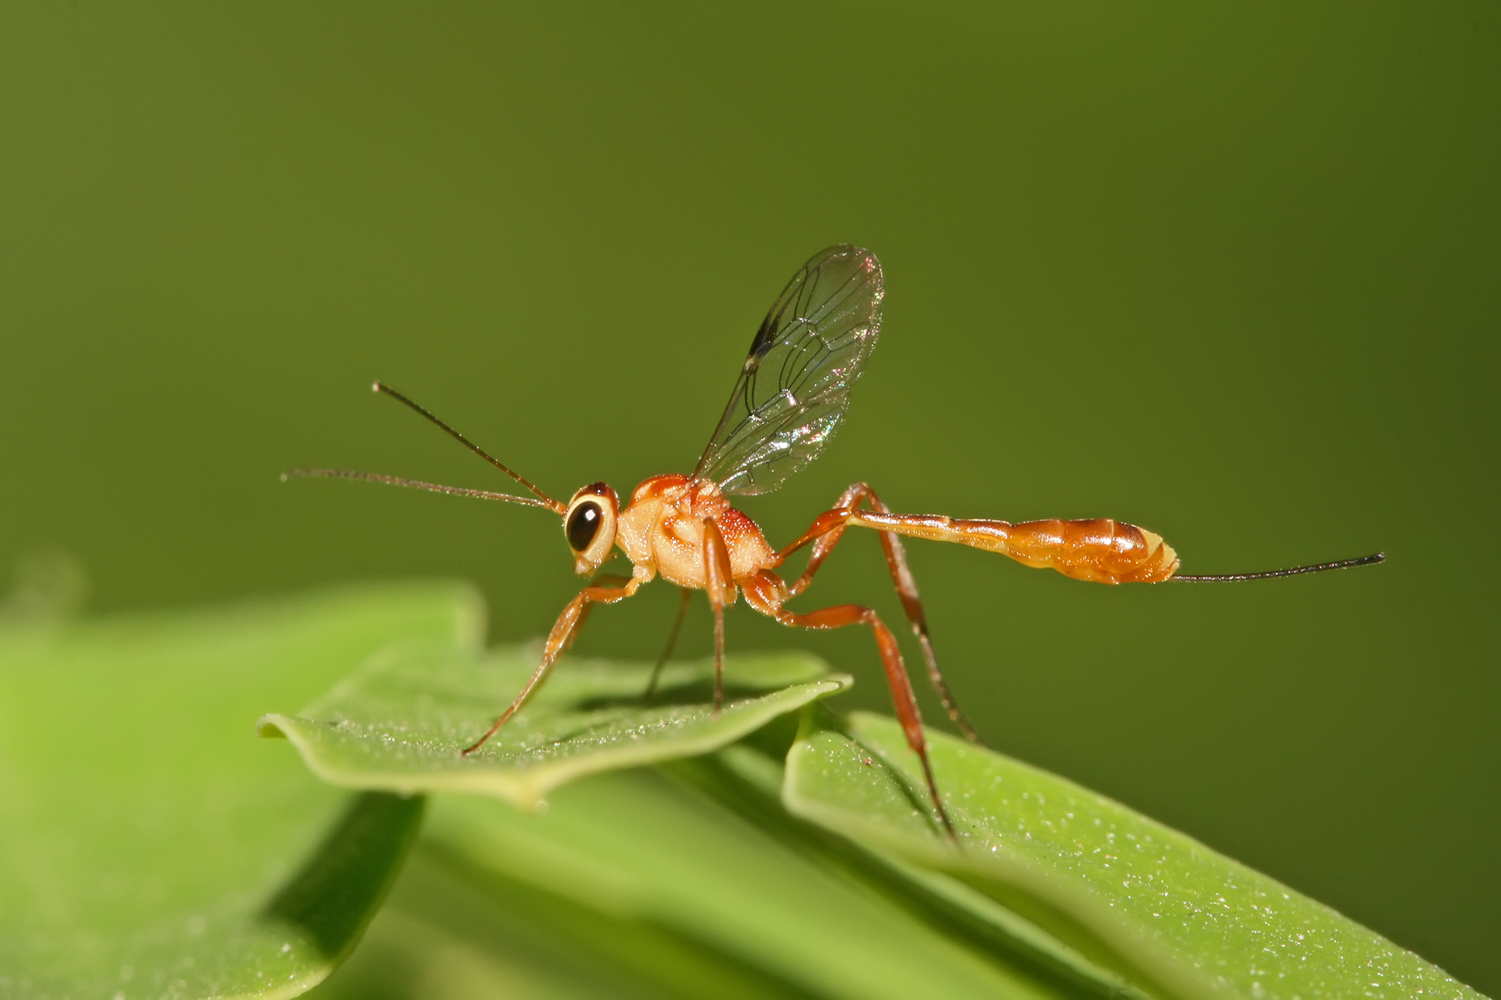
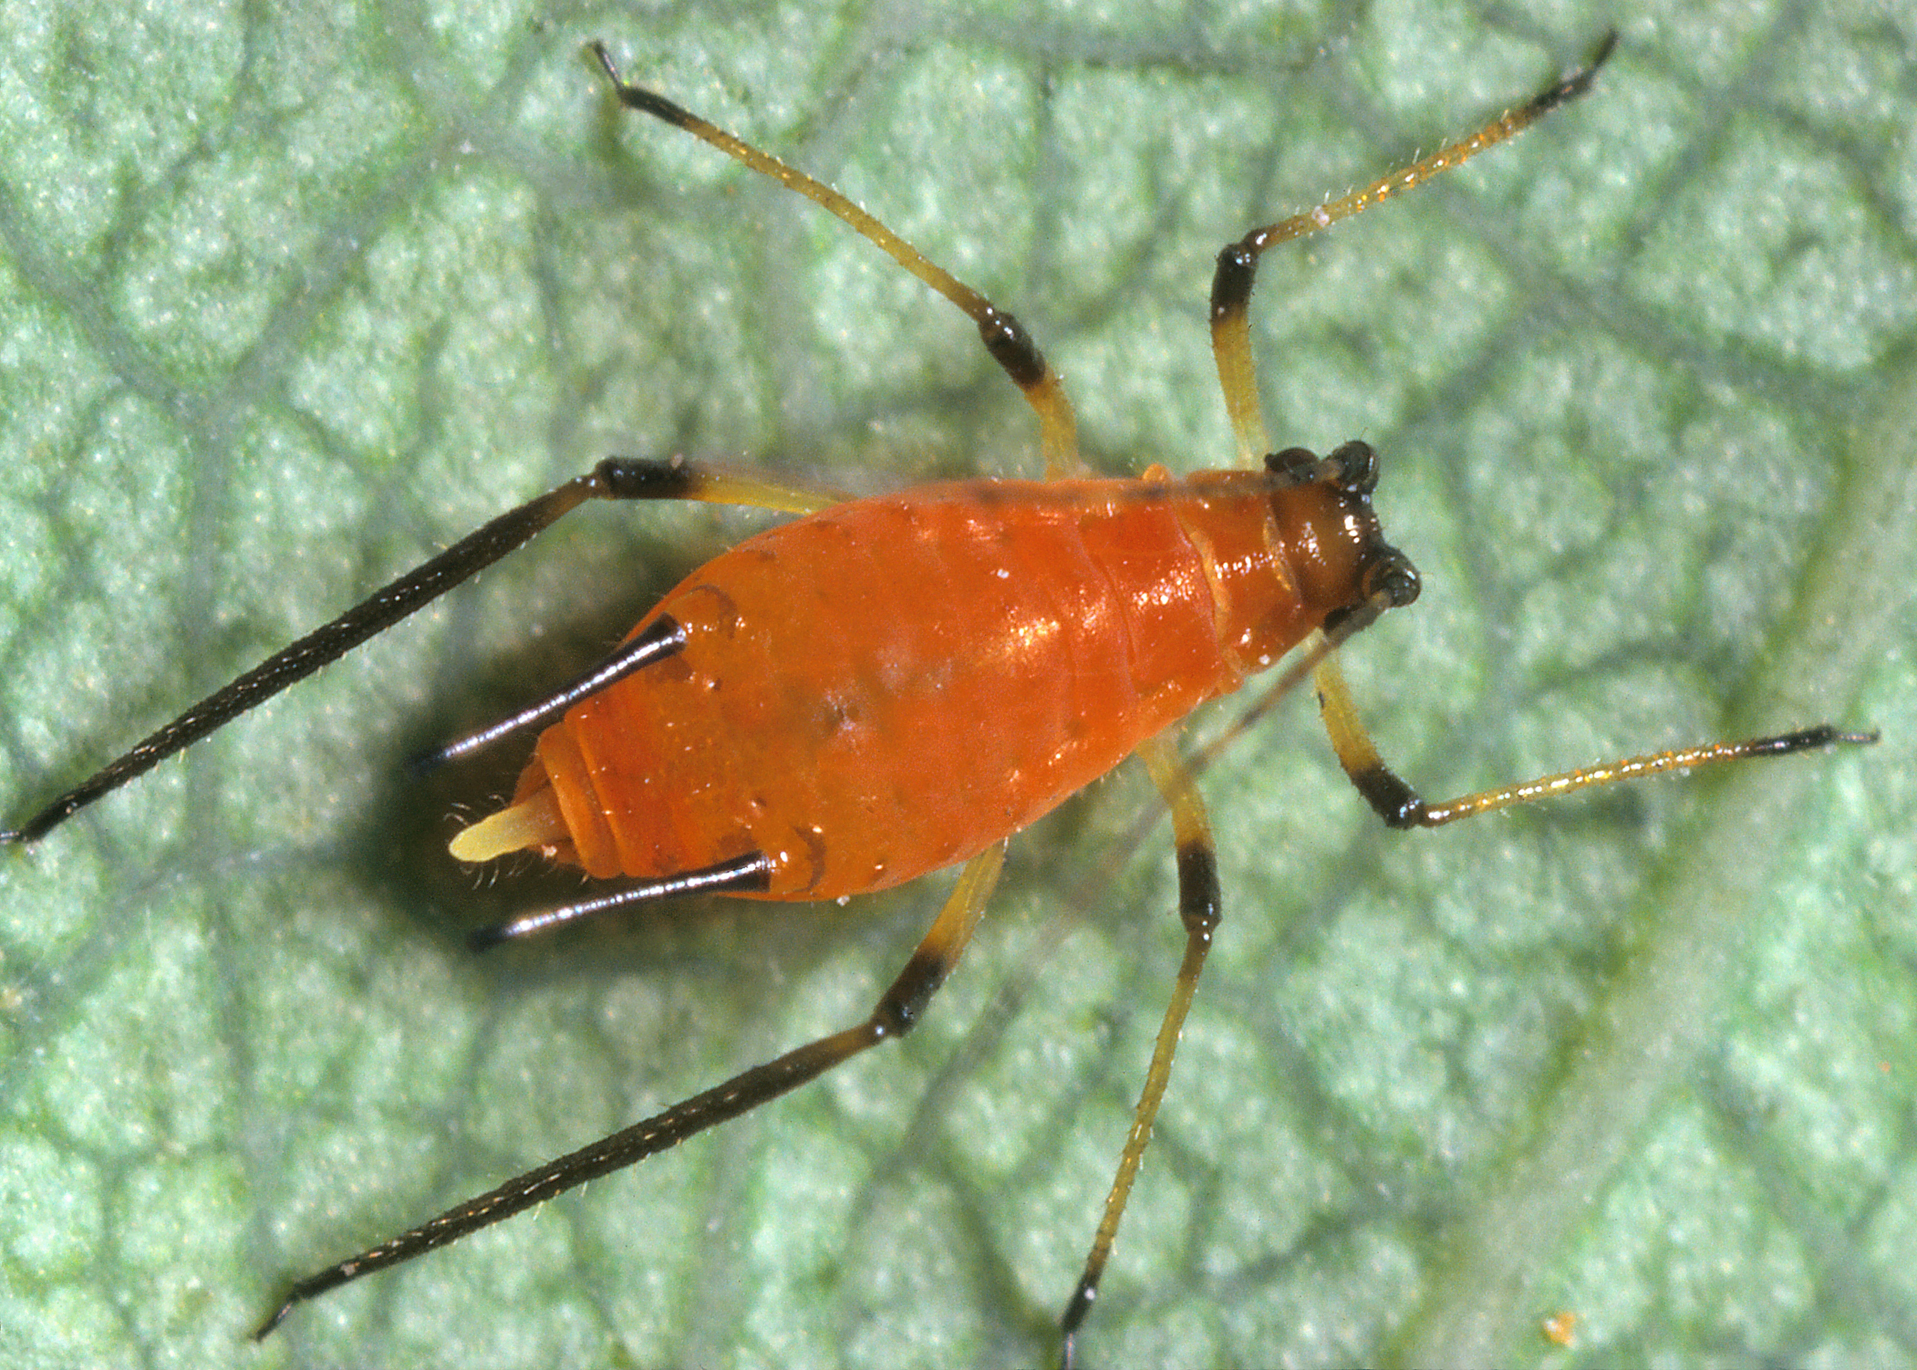
There area also inverse latitudinal gradients (lower richness in the tropics)
Ichneumonids
Aphids
Marine benthic algae
Pitcher platn mosquito
Shallow-water molluscs
Kindlmann et al. (2005) Chapter in “Scaling Biodiveristy” by Storch et al.

Slide 11
You should know
Latitudinal gradient of species diversity is one of the most pronounced macroecological patterns
It’s fascinated ecologists for centuries
For majority of taxa, the latitudinal gradient consists of high diversity in the tropics, and its decrease towards the poles
However, the decrease is not always monotonous, sometimes there are humps
There are taxa in which we observe and inversed latitudinal gradient

Slide 12
Explaining the latitudinal gradient
There is > 30 hypotheses
Notes:
I am qualified to deliver all this

Slide 13
1. Geometry, statistics, mathematics
Perhaps there is nothing biological about biodiversity patterns
Notes:
I am qualified to deliver all this

Slide 14
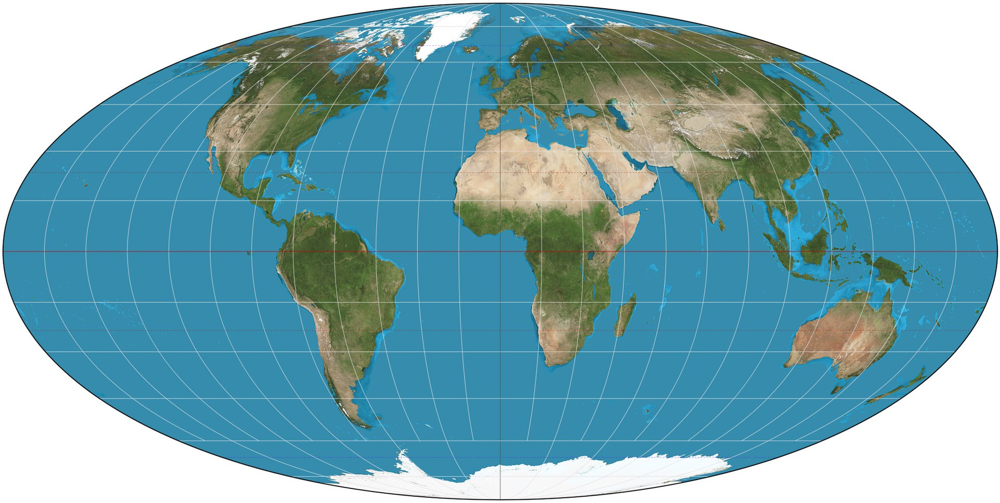
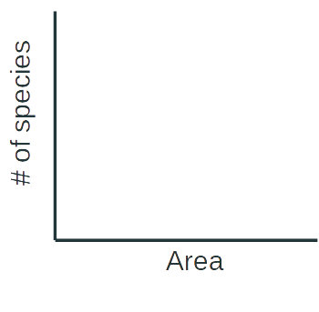

The tropics are bigger… or, are they really?
Rosenzweig (1995) Species Diversity in Space and Time
Rohde (1997) Oikos

Slide 15
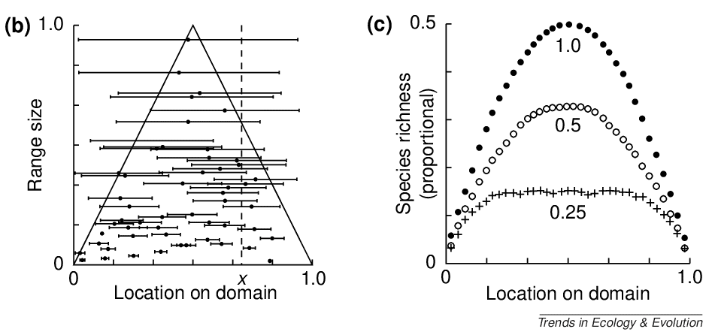
The mid-domain effect (MDE)
MDE: The increasing overlap of species ranges towards the center of a geographic domain due to geometric boundary constraints in relation to the distribution of species' range sizes and midpoints.
Colwell & Lees (2000) Trends in Ecology & Evolution

Slide 16
The mid domain effect in two dimensions – the spreading dye model
The best model combines the geometric mid-domain effect with climatic effects, specifically actual evapotranspiration (AET).
Storch et al. (2006) Ecology Letters

Slide 17
You should know
Some explanations of macroecological patterns don’t operate with biological mechanisms, but rely on pure geometrical constraints on the world
For example, it was proposed that the tropics are so diverse because they are larger. Unfortunately, that is not the case.
Another example of the geometrical explanation is a “mid domain effect”, which also works well in conjunction with some of the more biological mechanisms

Slide 18
2. Climate
Is it warm, wet, productive, or stable climate that generates high biodiversity?

Slide 19
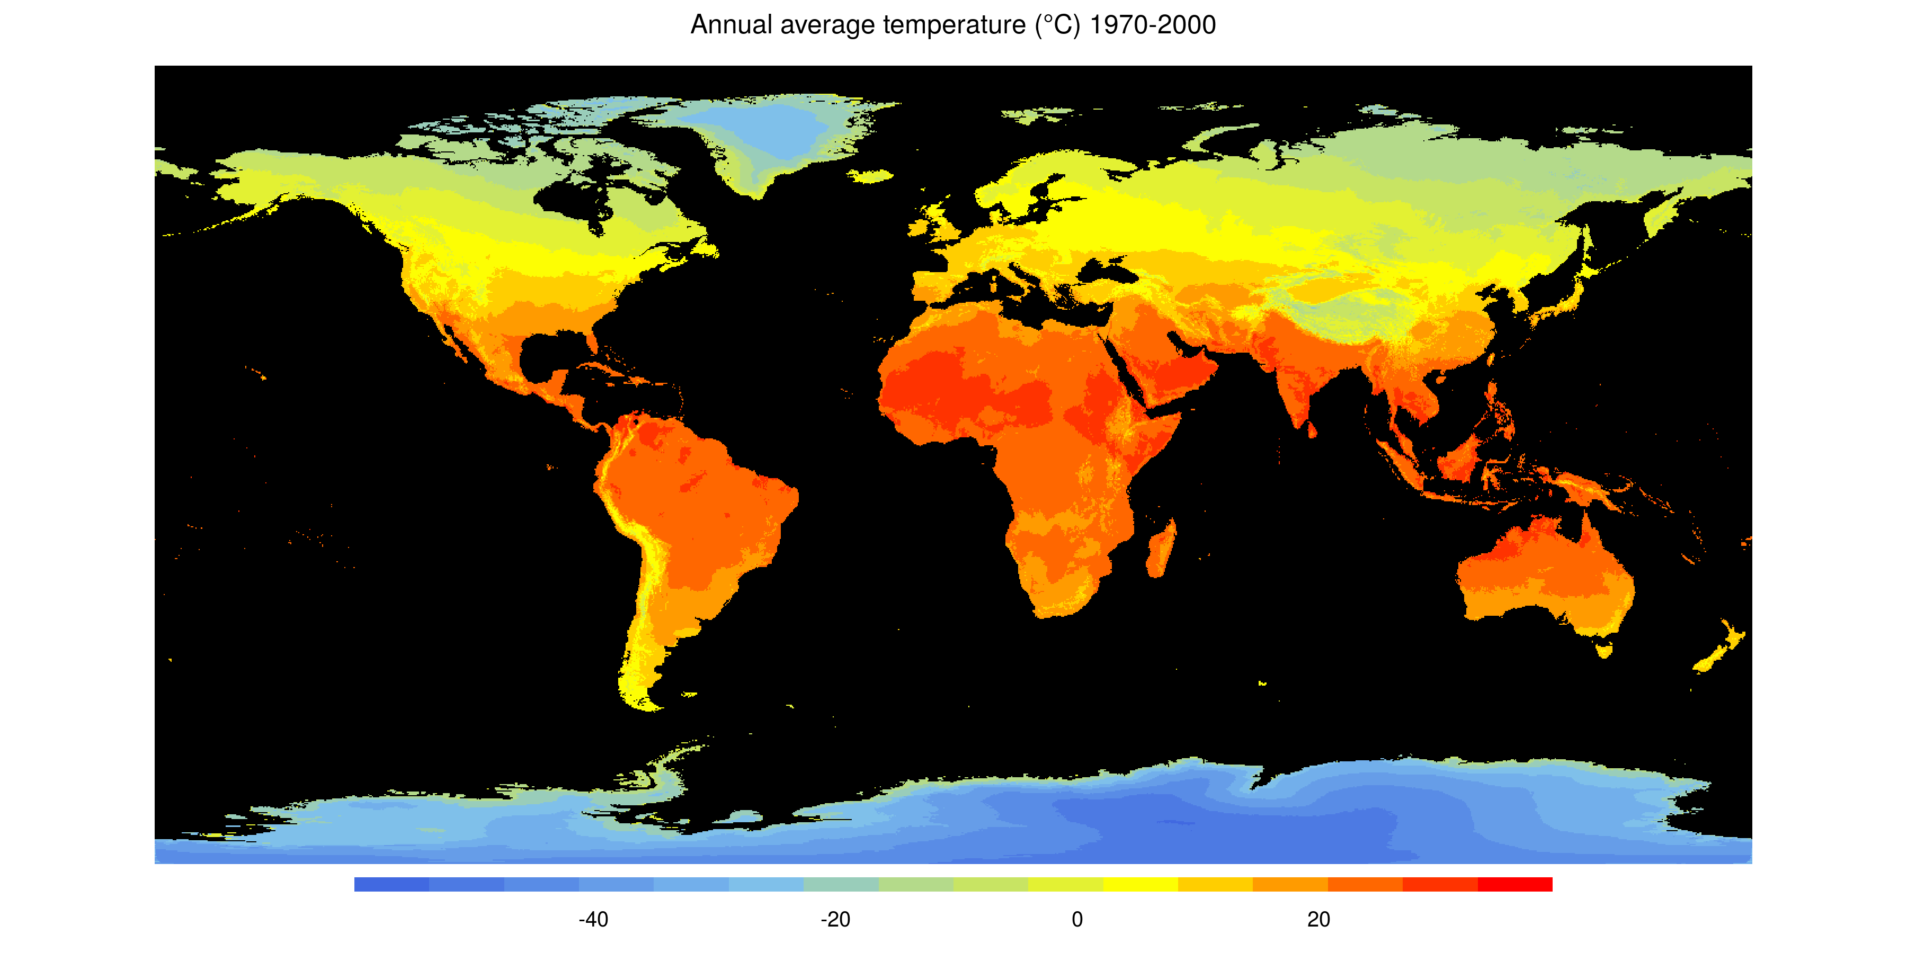
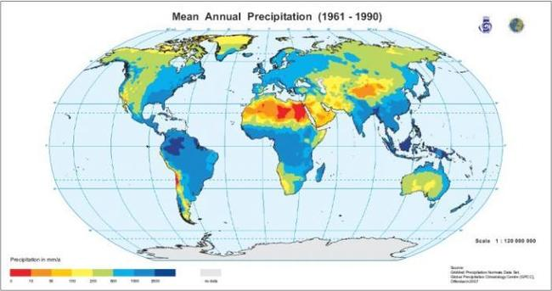
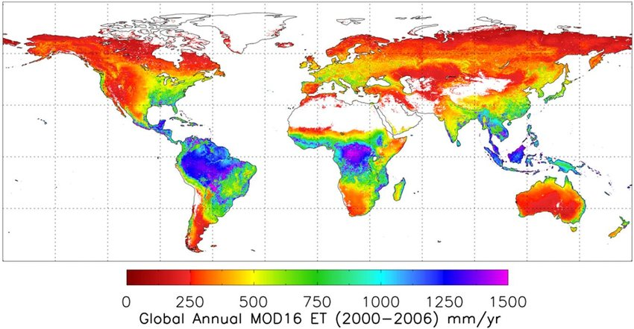
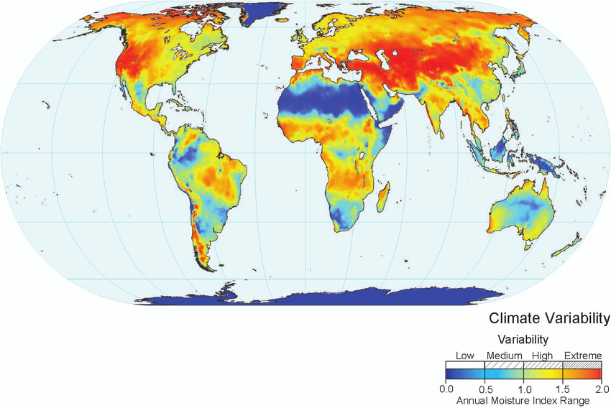
Temperature, precipitation, evapotranspiration, variability (seasonality)

Slide 20
Evapotranspiration – a proxy for energy input
Global species richness of birds
Hawkins et al. (2003) Ecology

Slide 21
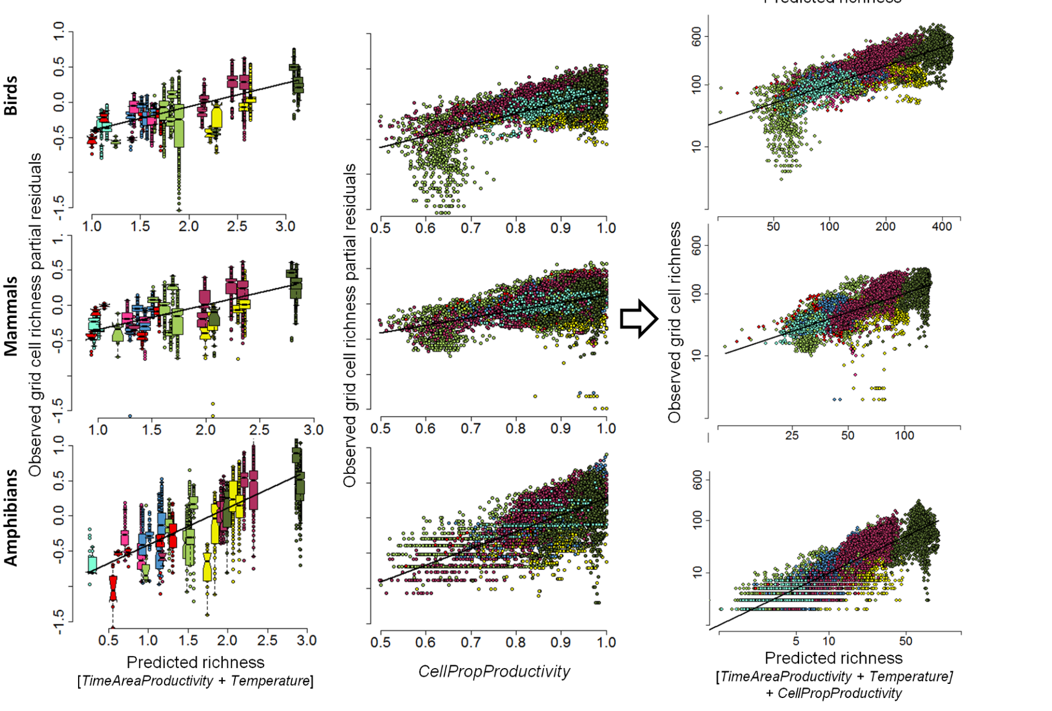
Net Primary Productivity
Jetz & Fine (2012) PLoS Biology

Slide 22
More Individuals Hypothesis (MIH)
The MIH states that when there is more energy available, there are more individuals, thus populations are on average larger, thus they are less susceptible to extinctions, thus there is higher species richness.
Storch et al. (2019) Ecology Letters

Slide 23
Rohde’s hypothesis
Warmer areas:
-> faster reactions -> more mutations -> faster speciation -> more species
or
-> faster generation times -> faster speciation -> more species
Rohde (1992) Oikos

Slide 24
Metabolic theory – faster metabolism, faster evolution, faster speciation, more species
Simova et al. (2011) Global Ecology and Biogeography

Slide 25
Metabolic theory – faster metabolism, faster evolution
Allen et al. (2002) Science

Slide 26
Climatic limits
Hawkins et al. (2003) Ecology

Slide 27
Climatic limits
Simova et al. (2011) Global Ecology and Biogeography

Slide 28
Climatic limits
Simova et al. (2011) Global Ecology and Biogeography

Slide 29
You should know
Species diversity strongly and consistently covaries with climate, with warmer and wetter areas being usually richer in species
The best proxy for this warm & wet environments is evapotranspiration, and net primary productivity
Several hypotheses/theories have been proposed to explain this, for example:
The more individuals hypothesis
Metabolic theory
The effect of climatic limits

Slide 30
3. Environmental heterogeneity
More habitats, more species?
Notes:
I am qualified to deliver all this

Slide 31
Empirical support – a global meta-analysis
Stein, Gerstner & Kreft (2014) Ecology Letters

Slide 32
Empirical support – a global meta-analysis
Stein, Gerstner & Kreft (2014) Ecology Letters

Slide 33
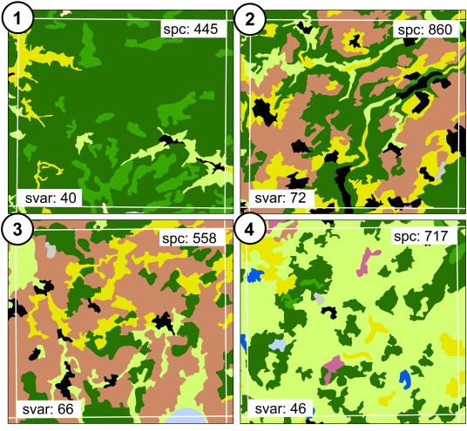
Spectral variability hypothesis – so far not well supported
Rocchini et al. (2010) Ecol. Informatics
Féret & Asner (2011) Rem. Sens. Environ.

Slide 34
You should know
Species diversity is broadly expected to co-vary with environmental heterogeneity
The logic is that more heterogeneous environments will offer more opportunities to species with different niches
The relationship is often observed, but it is not as strong as the relationship between diversity and climate

Slide 35
4. History: Dispersal limits & evolution

Slide 36
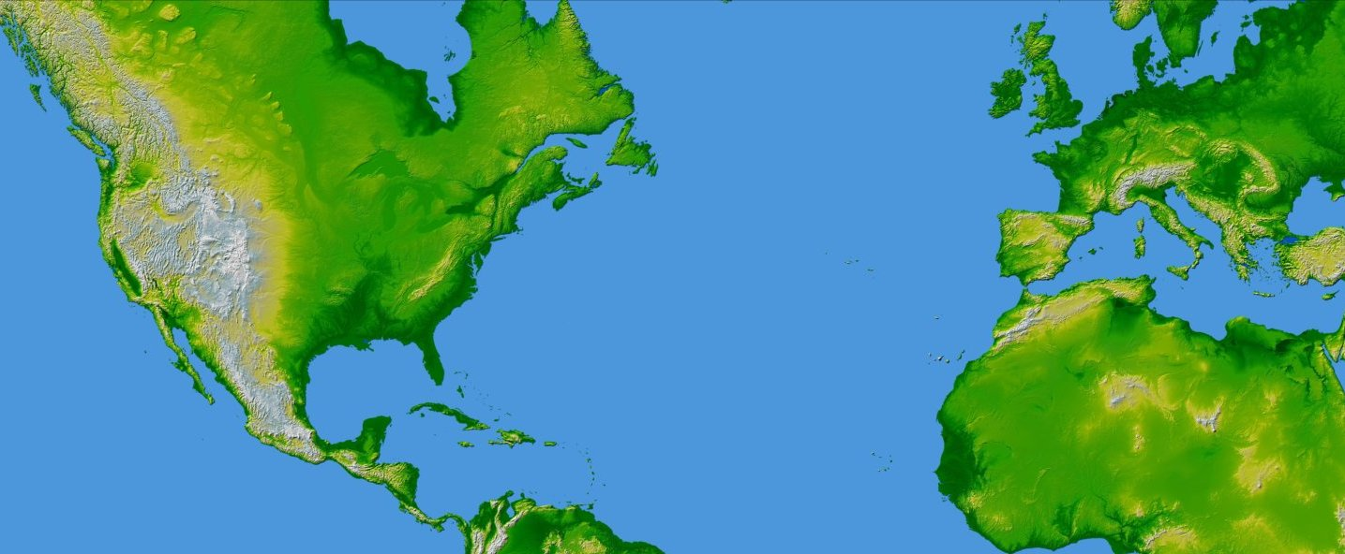
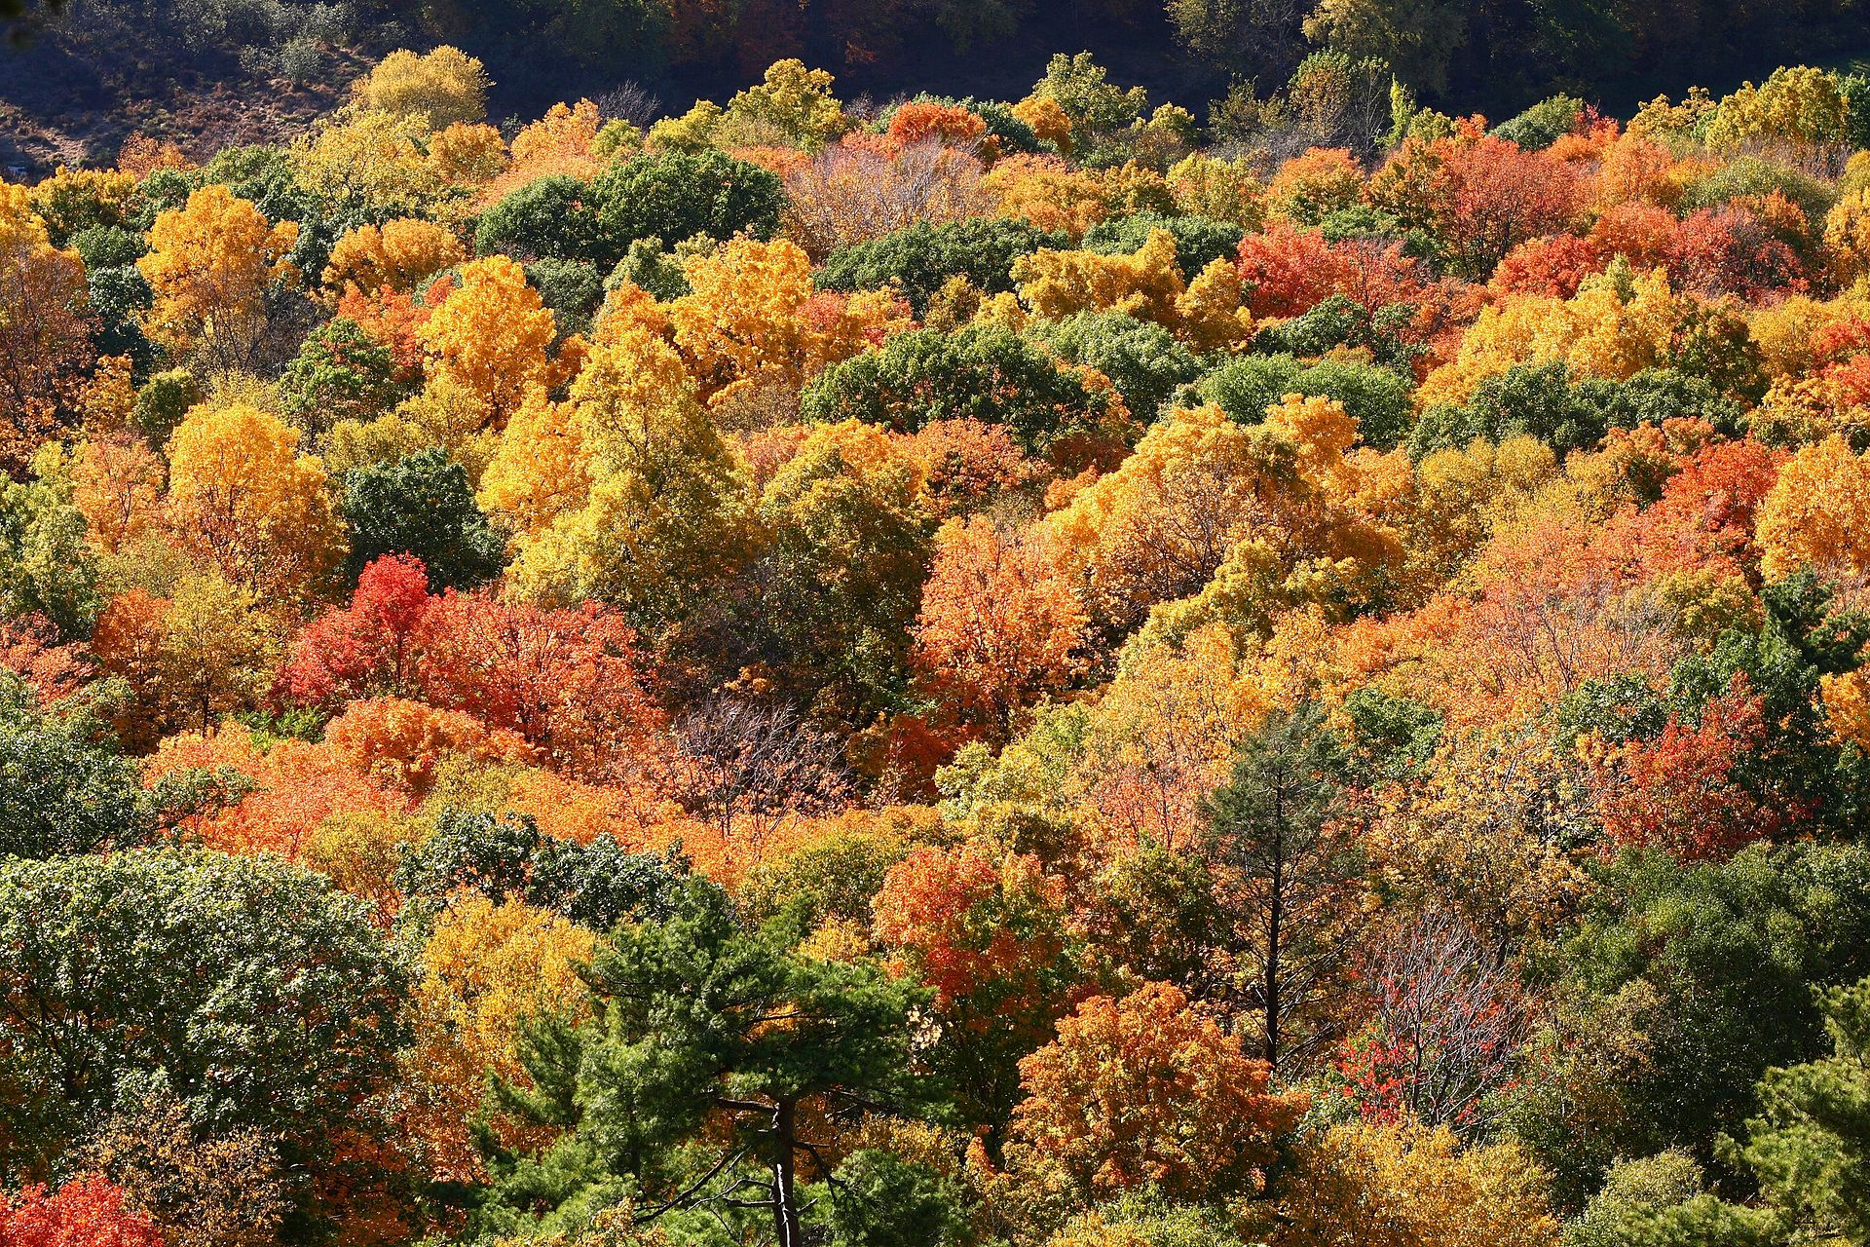
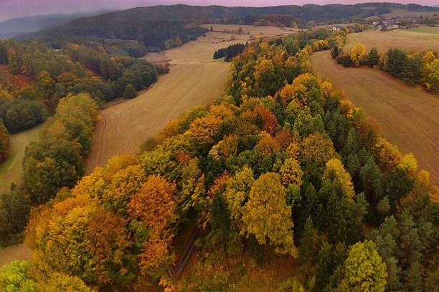
Dispersal limits
X
Connecticut, USA
Czech Republic, EU
Ricklefs & Schluter (1993), Keil & Chase (2019) Nature Ecology & Evolution
map from NASA (public domain)

Slide 37
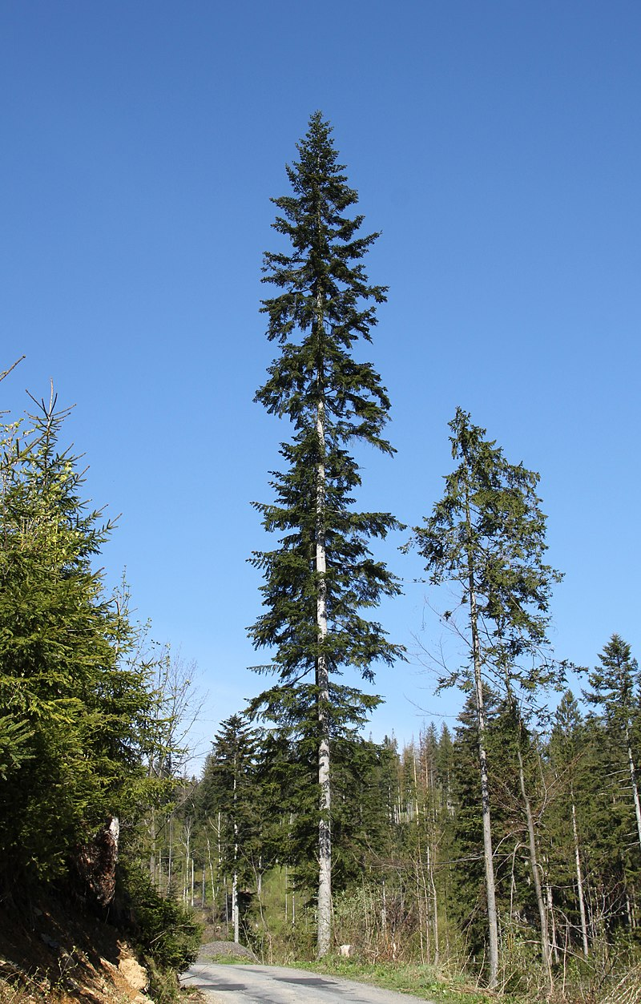
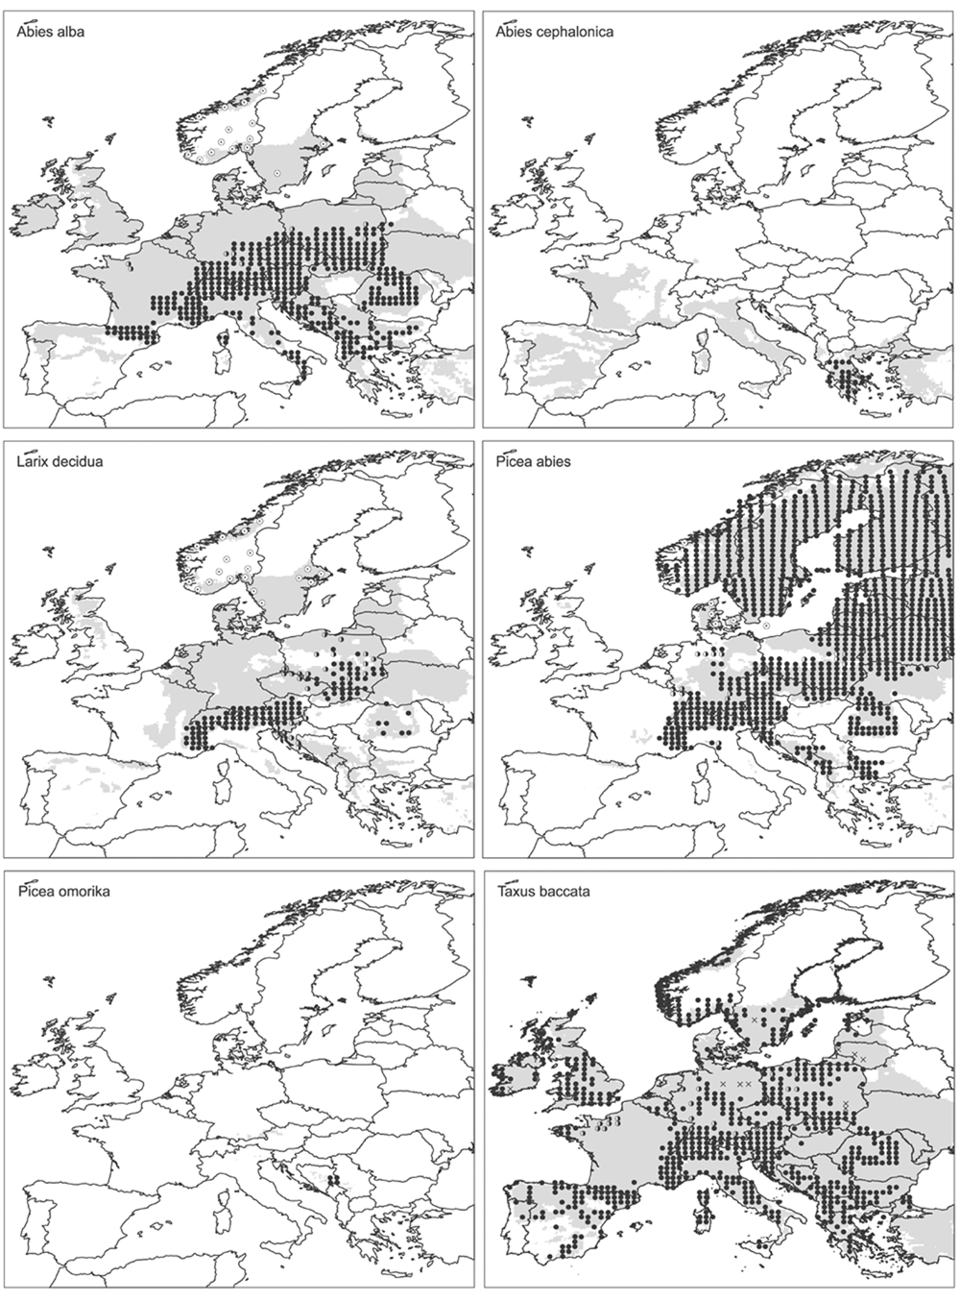
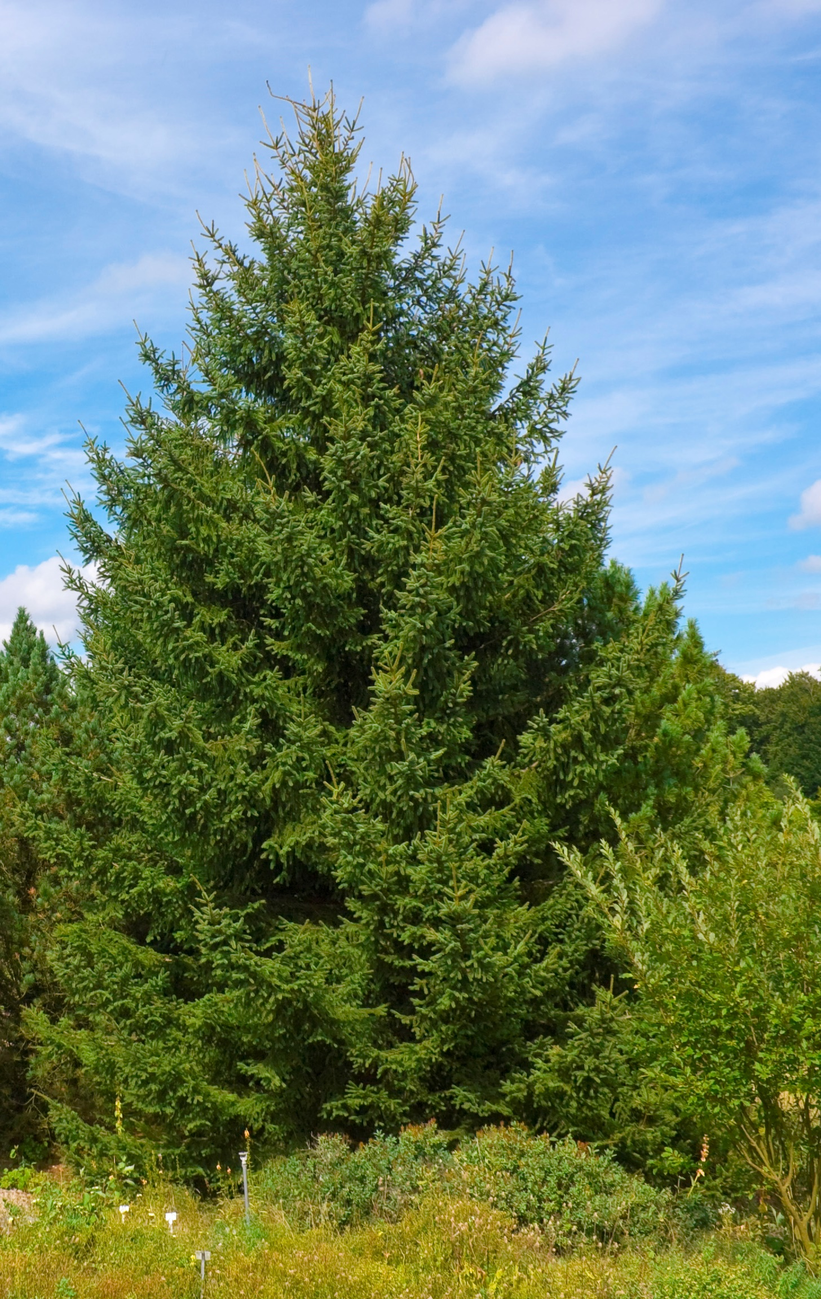
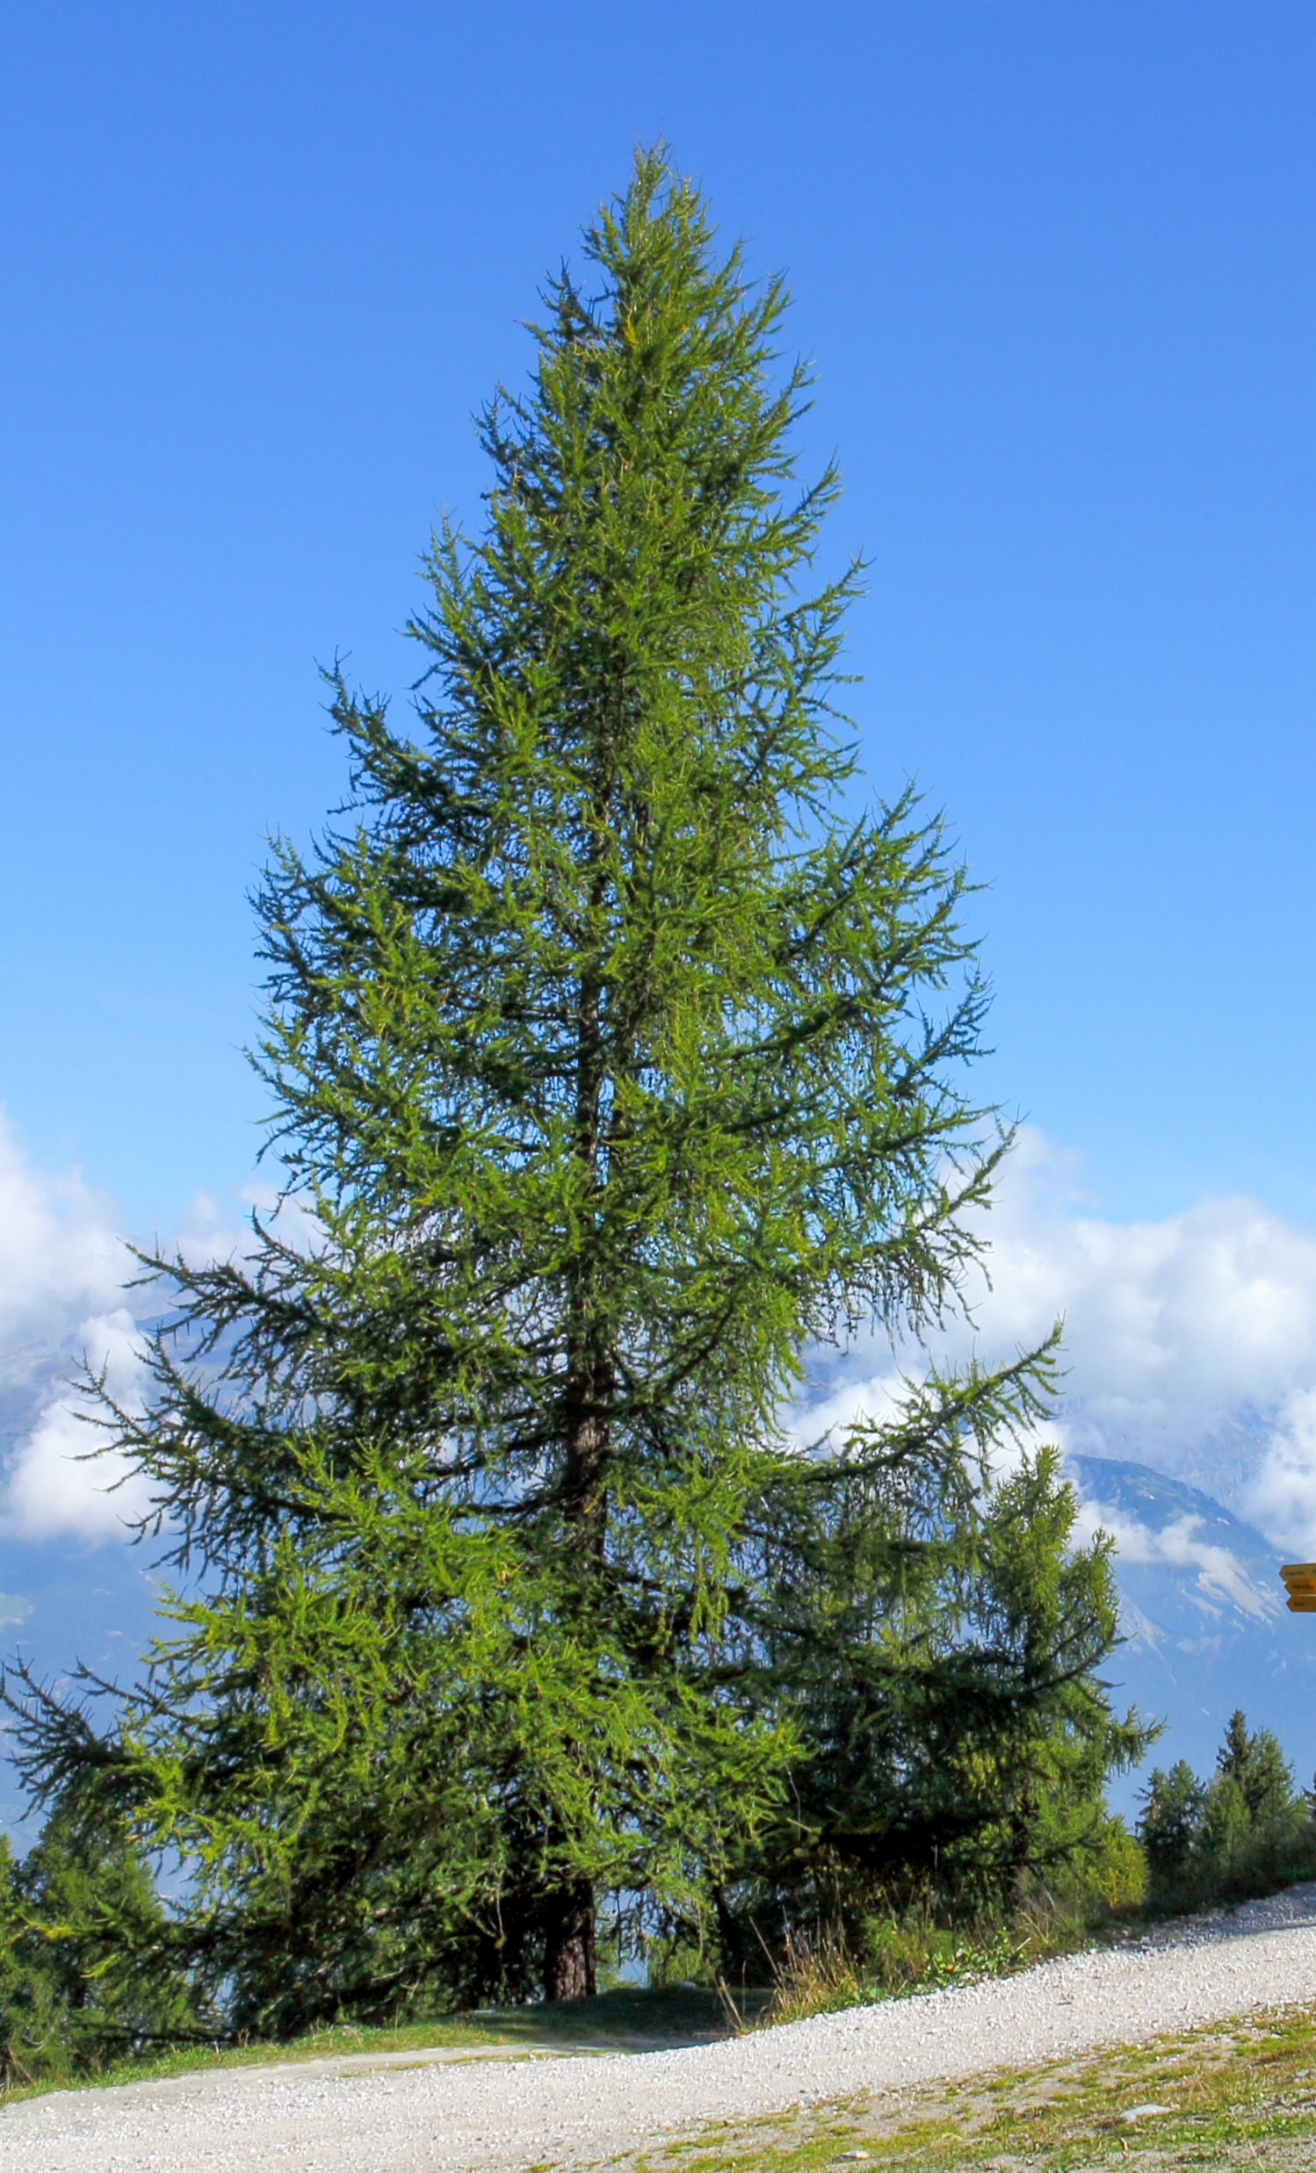
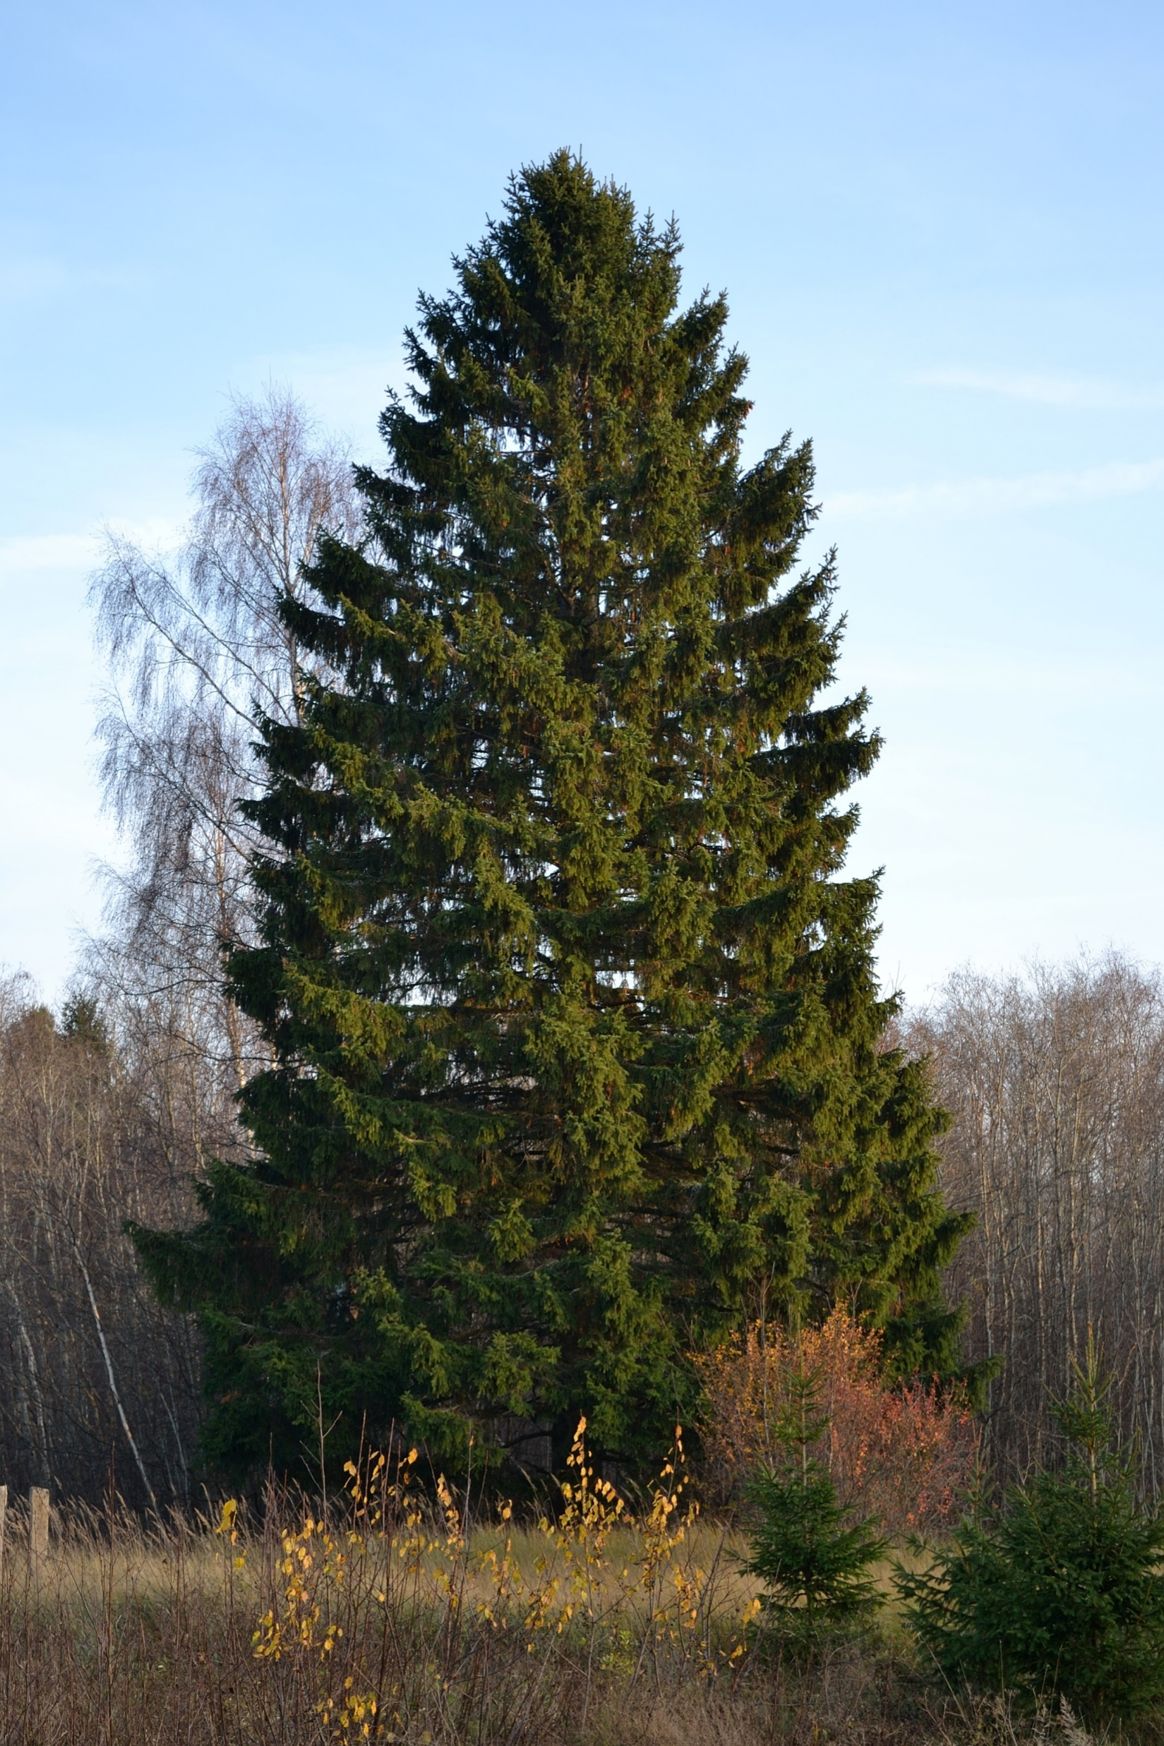
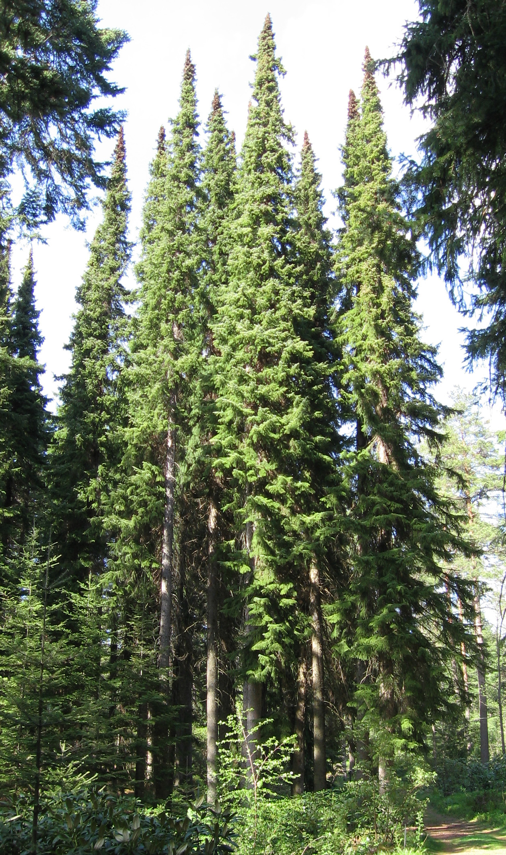
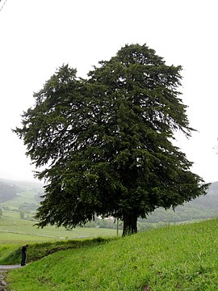
Dispersal limits
Svenning & Skov (2004) Ecology Letters

Slide 38
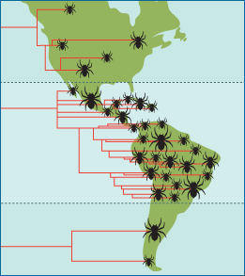
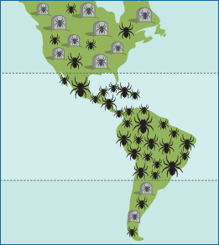
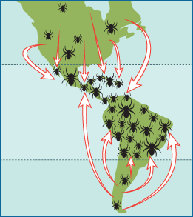
Tropics as cradle, or museum of biodiversity?
Tropics as a
cradle of biodiversity
Tropics as a
museum of biodiversity
Tropics as a
destination of biodiversity
= higher speciation in the tropics
= lower extinciton in the tropics
evolution.berkeley.edu

Slide 39
Tropics as cradle, or museum of biodiversity?
Rangel et al. (2018) Science
https://players.brightcove.net/53038991001/default_default/index.html?videoId=5810230822001

Slide 40
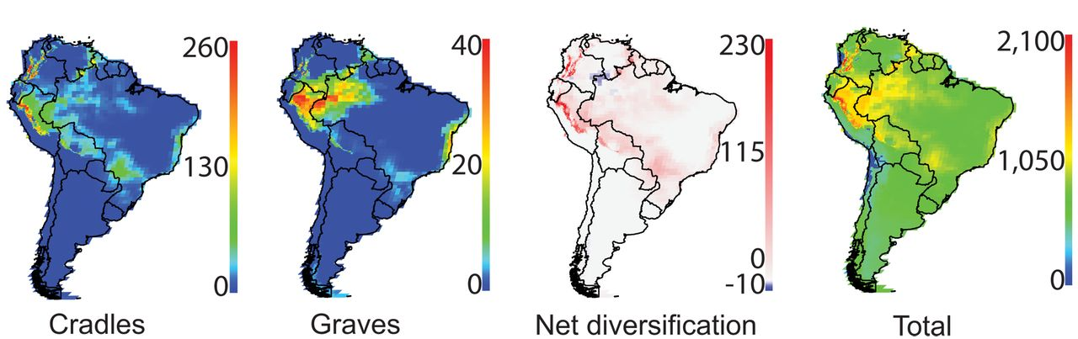
Tropics as cradle, or museum of biodiversity?
It looks like some regions of the tropics are cradles, while others are museums, yet others are graves.
Rangel et al. (2018) Science
https://players.brightcove.net/53038991001/default_default/index.html?videoId=5810230822001

Slide 41
You should know
Species dispersal limitations, and dispersal barriers play a crucial role in shaping global patterns of species diversity
Examples are European trees, whose diversity still catches up with environmental changes that happened after the last glacial maximum
Often, dispersal limitations are linked to “historical” explanations of the latitudinal diversity gradient
Prominent historical explanations are that the tropics are either a cradle, a museum, or a destination for diversity
Which of these three applies has still not been unequivocally resolved

Slide 42
5. Stable tropics have more specialists

Slide 43
Tropics are more climatically stable (both long-term and short-term)

Slide 44
Stability leads to strong competition and specialization, thus higher richness

Slide 45

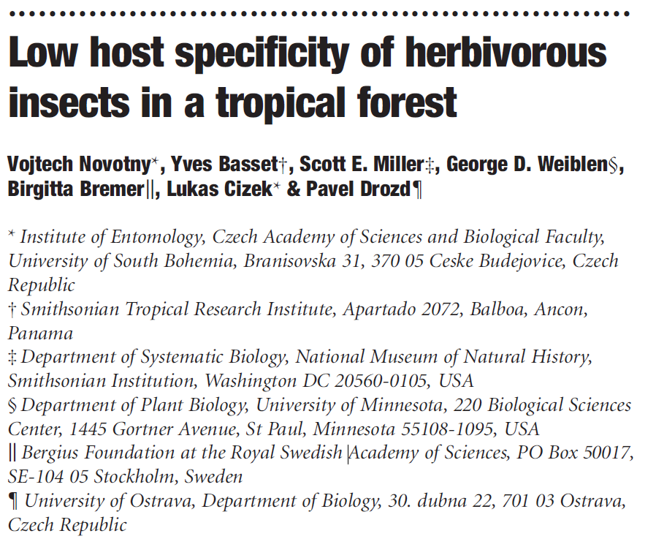
But are there more specialists in the tropics?
Novotny et al. (2002) Nature

Slide 46
Synthesis?
… and the role of scale in all this

Slide 47
Broadly, there is empirical support for most of these hypotheses
But … climatic drivers are most common.
Climate
Edaphic
Interacitons
Heterogeneity
Area
Dispersal, history
Field et al. (2009) Journal of Biogeography

Slide 48
And it is also all dependent on spatial grain
Field et al. (2009) Journal of Biogeography

Slide 49
And there is the problem of collinearity
Keil & Chase (2019) Nature Ecology and Evolution

Slide 50
You should know
Among the different explanations for the latitudinal gradient, many apply simultaneously
The strongest driver so far appears to be climate
The effect of the drivers depends on spatial gain (resolution)
However, the explanations are difficult to tease apart using only observational data, since geographic location, climate, and geometrical arrangements of continents are all correlated

Slide 51
Altitudinal (elevation) gradients of biodiversity
From the sea level upwards
Notes:
I am qualified to deliver all this

Slide 52
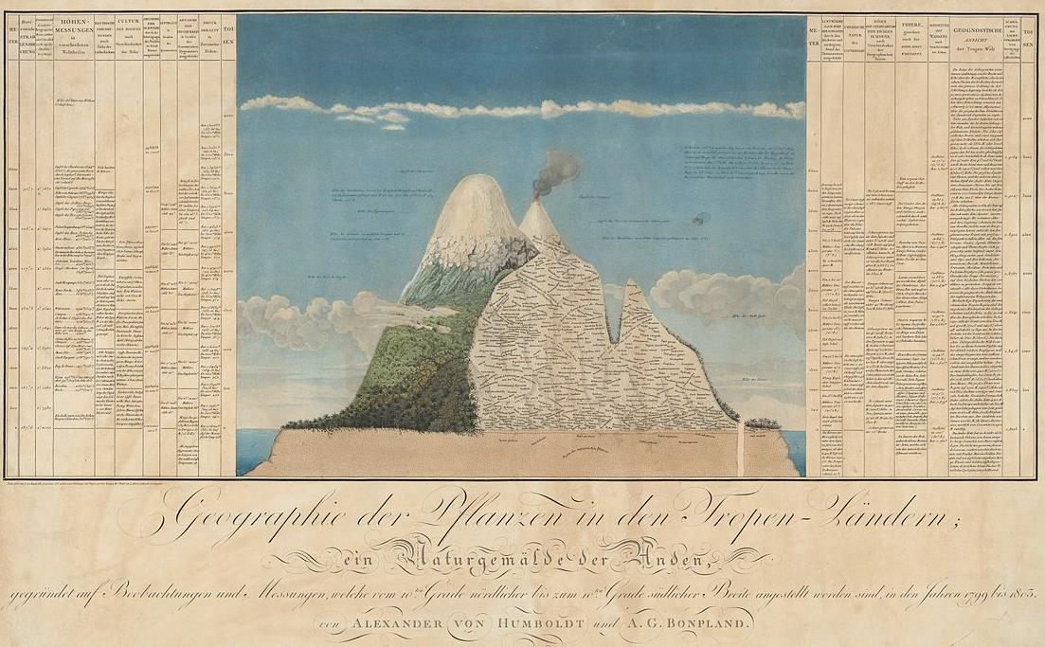
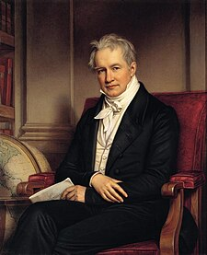
Elevational gradient of species richness – two types of a pattern
Alexander von Humboldt
Rahbek (1995) Ecography

Slide 53
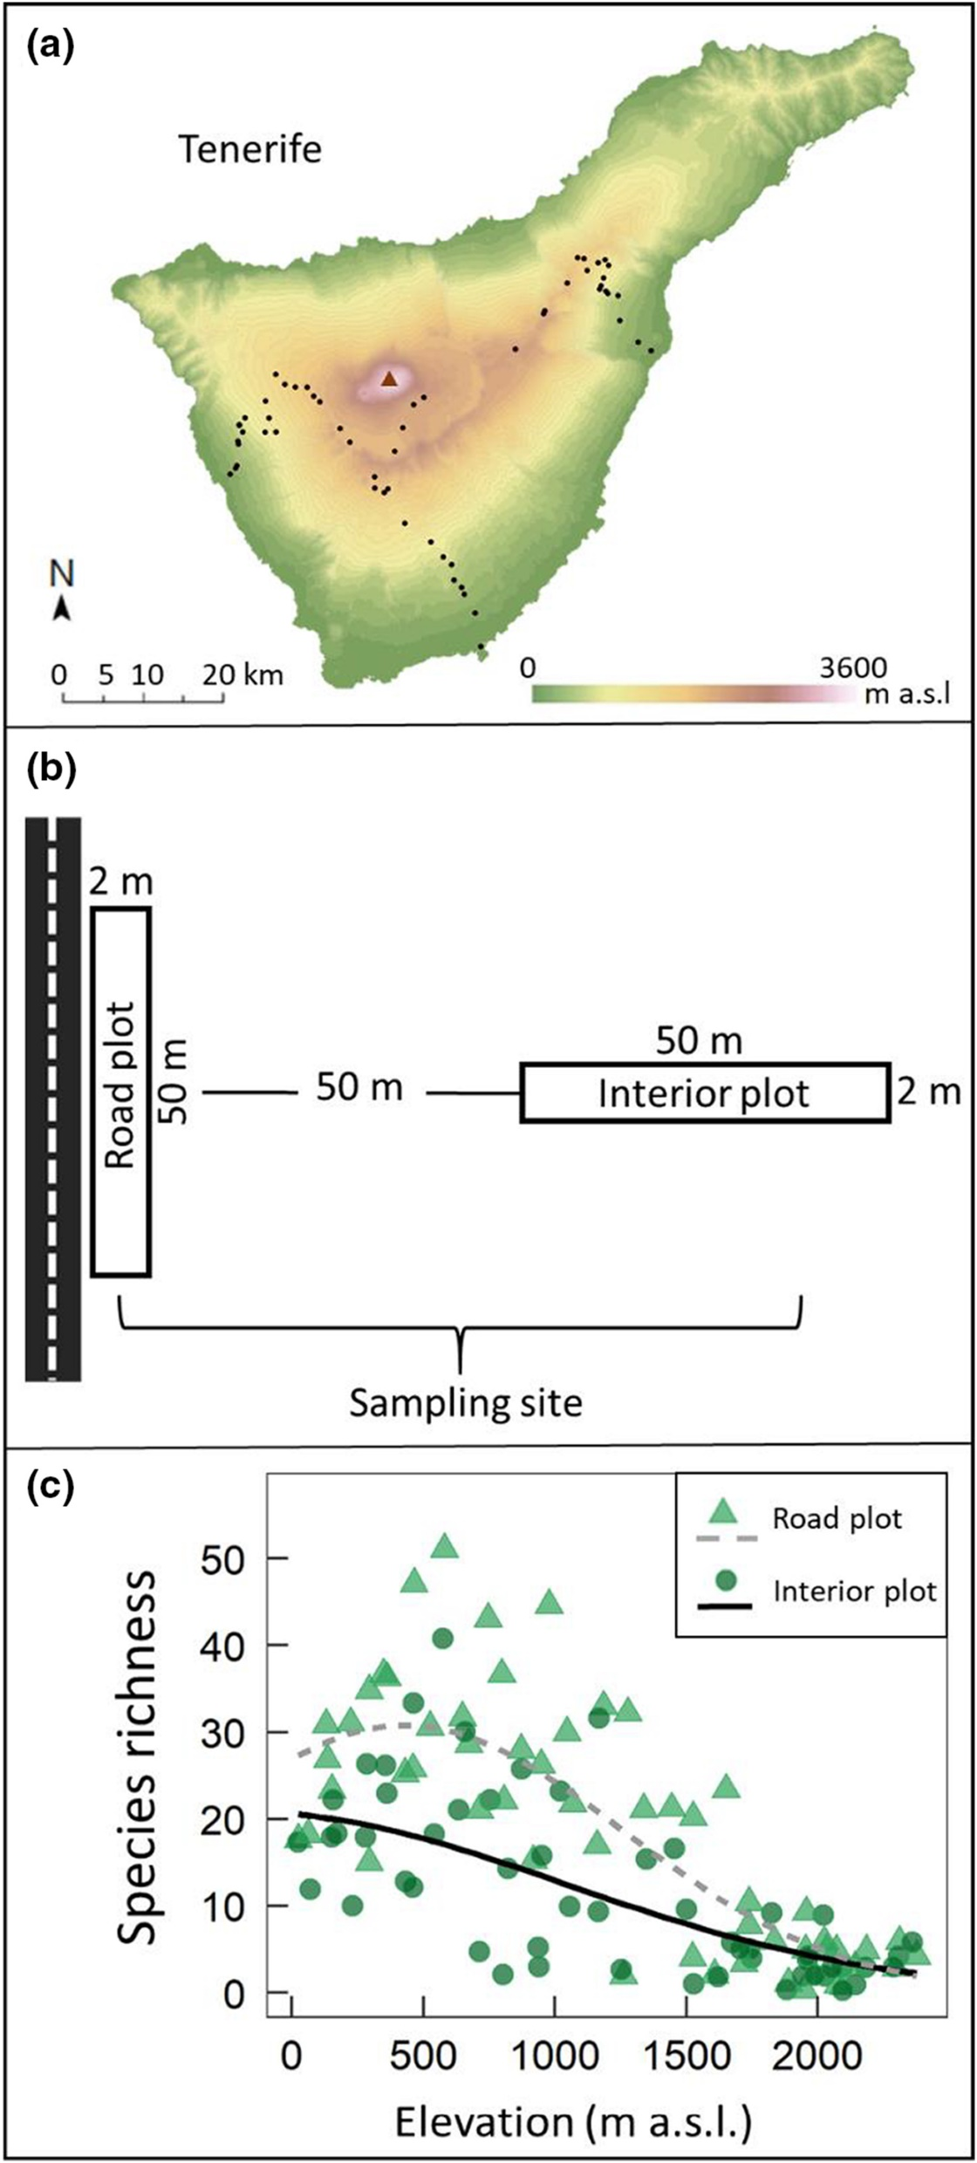

Elevational gradient of species richness
Backes et al. (2023) J. Veg. Sci.

Slide 54
Elevational gradient of species richness
Quintero & Jetz (2018) Nature

Slide 55
Likely a strong role of geometry
(a) Mid-domain effect again
(b) Decreasing area
Colwell & Lees (2000) Trends in Ecology & Evolution

Slide 56
Several mechanisms operate simultaneously, not yet clear which dominates
On top of the geometry:
Productivity – higher elevations are cold and unproductive
UV radiation – higher mutation rates
Gravitation (water flows down)
Hypoxia, hypothermia, thinner air promote weird adaptations
Refugia – mountains historically served as refugia (e.g. during ice ages)
Mixing of competitive lowland biota with stress-tolerant alpine biota – mid elevations have both
Strong boundaries of habitats – edge effects
Rahbek (1995) Ecography

Slide 57
You should know
That there is an altitudinal gradient of diversity that partly mirrors the latitudinal one
Hypotheses have been proposed that operate with climatic, biotic, and geometrical drivers
The debate has not yet been resolved

Slide 58
Thank you. Questions?

